Slide 1
8. Probabilistic Information Retrieval

Slide 2
Probabilistic Information Retrieval
The notion of similarity in the vector space model does not directly imply relevance
The similarity values have no interpretation, they are just used to rank
An information retrieval model deals with uncertainty on the users information needs
Probability theory provides a principled approach to reason about this uncertainty
Probabilistic IR models attempt to directly model relevance as a probability
Notes:
One of the key drawbacks of the vector space retrieval model is the lack of interpretability of the similarity values. This gave rise to the development of probabilistic retrieval models, that attempt to “compute” relevance as a probability.

Slide 3
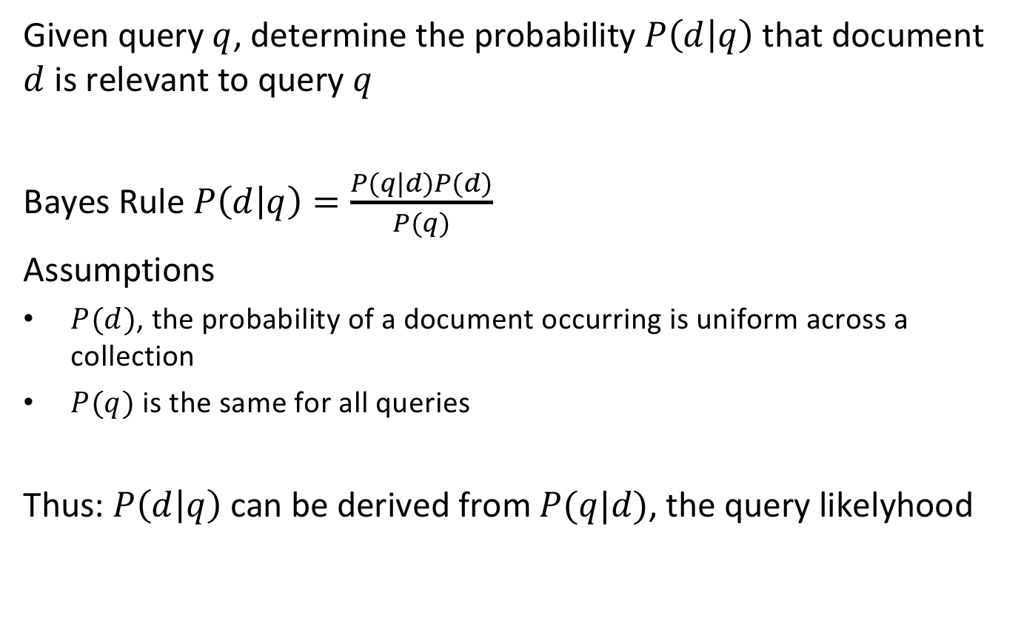
Query Likelihood Model
Given query $q$, determine the probability $P\left(d | q\right)$ that document $d$ is relevant to query $q$
Bayes Rule $P\left(d | q\right)=\frac{P(q|d)P(d)}{P(q)}$
Assumptions
$P(d)$, the probability of a document occurring is uniform across a collection
$P(q)$ is the same for all queries
Thus: $P\left(d | q\right)$ can be derived from$P(q|d)$, the query likelyhood
Notes:
The problem of retrieval can be understood in a probabilistic setting as the problem of determining the probability of a document d being relevant, given a query q. We observe that the probability of a document to occur in a collection is constant (which makes sense assuming all documents are different), and the probability of a query to occur is the same for all documents. Thus, using Bayes rule, the problem of determining whether a document is relevant for a query is equivalent to the problem of determining whether a query is relevant to a document. The latter probability P(q|d) is also called the query likelihood.

Slide 4
Language Modeling
Query likelihood: determine $P\left(q | d\right)$
Assume each document $d$ is generated by a Language Model $M_{d}$
a language model is a mechanism that generates the words of the language
Then $P\left(q | d\right)$ can be interpreted as the probability that the query $q$ was generated by the language model $M_{d}$
Notes:
The notion of query likelihood gives now rise to the following approach to model relevance. We assume that documents are the result of language model. A language model is a (in general probabilistic) process that produces text, and a given document d is assumed to be produced by its specific language model M_{d}. Then the problem of retrieval can be viewed in the following way: if a query is relevant to a document, it should have been produced by the same language model as the document. Using this argument, the query likelihood corresponds to the probability that the query has been produced by the same language model as the document.
Let’s have now a more detailed look in what a language model is and how we use it implement this intuitive model practically.

Slide 5
What is a Language Model?
Deterministic language model = automaton = grammar
This model can produce: “information retrieval” “information retrieval information retrieval”
It cannot produce: “retrieval information”
information
retrieval
Notes:
In the simplest case a language model is a deterministic automaton. In theoretical computer science deterministic automatons are those that can recognize (or produce) regular languages.

Slide 6
Probabilistic Language Model
Unigram model: assign a probability to each term to appear
More complex models can be used, e.g., bigrams
Model M₁ |  | Model M₂
STOP | 0.2 | STOP | 0.25
the | 0.2 | the | 0.15
a | 0.1 | a | 0.12
frog | 0.03 | frog | 0.0002
toad | 0.03 | toad | 0.0001
said | 0.02 | said | 0.01
likes | 0.015 | likes | 0.01
dog | 0.01 | dog | 0.04
Q
STOP
Two different language models derived from 2 documents
Notes:
Instead of using a deterministic automaton, we can also use a probabilistic state automaton, in other words, a Markov process. In the simplest case the automaton has a single state, and every state transition emits with a certain probability one term out of a vocabulary. In addition, the automaton can stop with a certain probability. The table captures the transition probabilities of two possible models M1 and M2. In the two models, the probability to stop is given as P(STOP|Q) = 0.2.

Slide 7
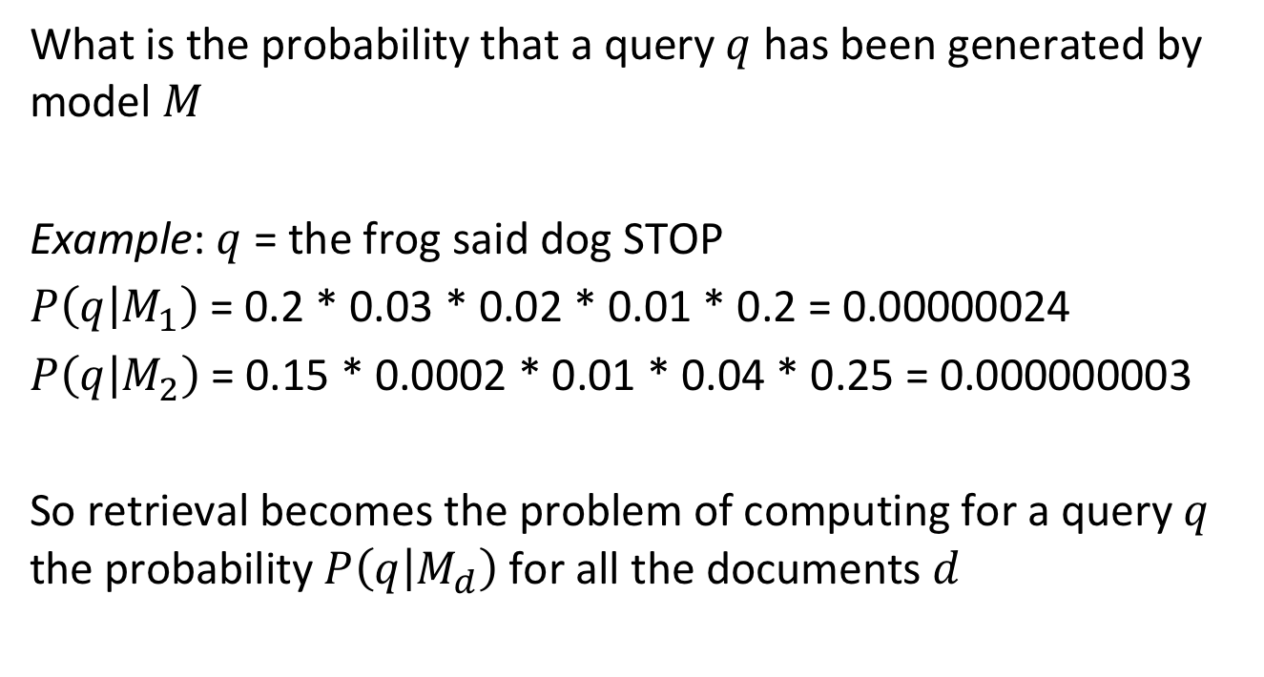
Probability to Create a Query
What is the probability that a query $q$ has been generated by model $M$
Example: $q$ = the frog said dog STOP
$P\left(q | M_{1}\right)$= 0.2 * 0.03 * 0.02 * 0.01 * 0.2 = 0.00000024
$P\left(q | M_{2}\right)$= 0.15 * 0.0002 * 0.01 * 0.04 * 0.25 = 0.000000003
So retrieval becomes the problem of computing for a query $q$ the probability $P\left(q | M_{d}\right)$for all the documents $d$
Notes:
Given a language model for the generation of documents, we can now compute within that model the probability that a given query q has been generated by the model of a document d. We give one example showing such a computation. With this approach we are now ready to compute query likelihood for all documents of a document collection.

Slide 8
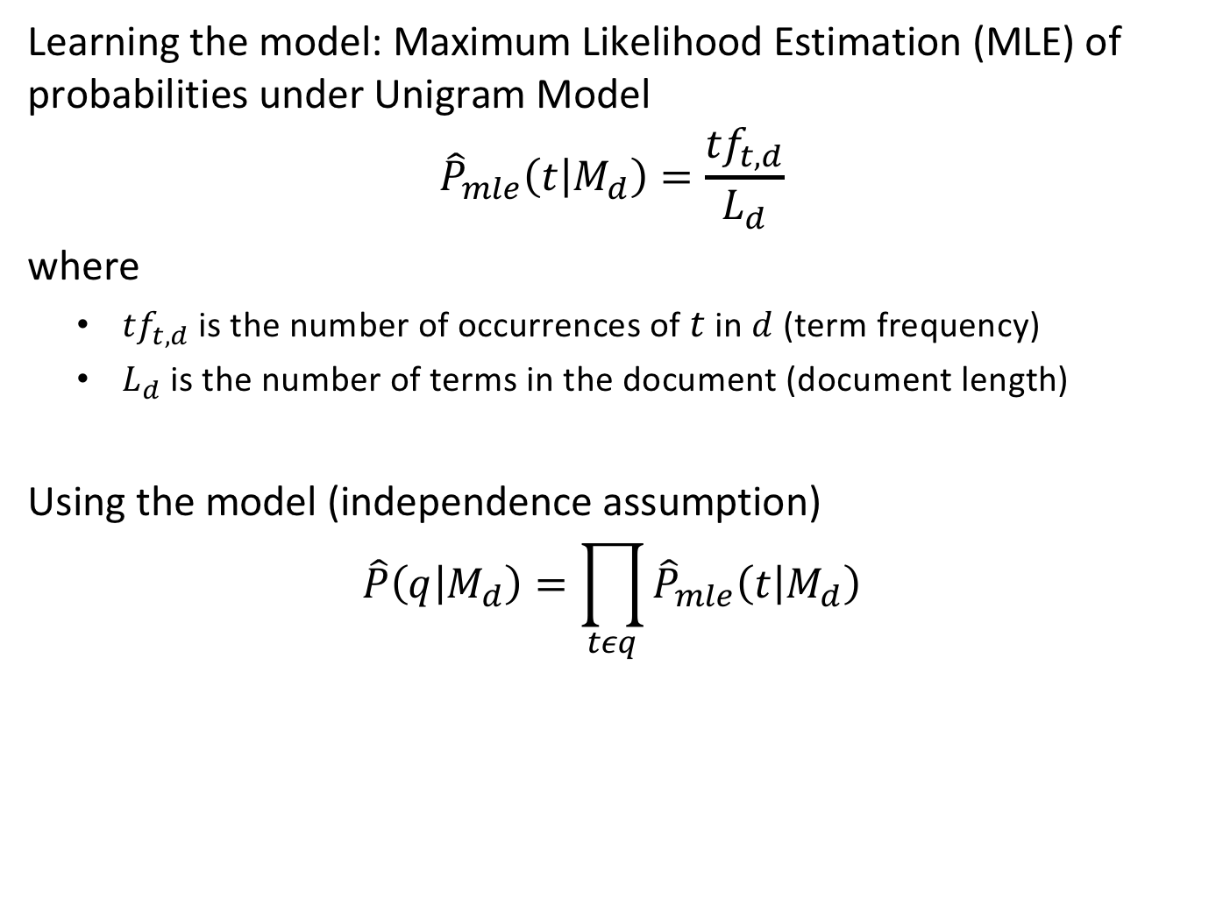
Learning and Using the Model
Learning the model: Maximum Likelihood Estimation (MLE) of probabilities under Unigram Model
$${\hat{P}}_{mle}\left(t | M_{d}\right)=\frac{{tf}_{t,d}}{L_{d}}$$ where
${tf}_{t,d}$ is the number of occurrences of $t$ in $d$ (term frequency)
$L_{d}$ is the number of terms in the document (document length)
Using the model (independence assumption)
$$\hat{P}\left(q | M_{d}\right)=\prod_{tεq}{{\hat{P}}_{mle}\left(t | M_{d}\right)}$$
Notes:
For applying the probabilistic retrieval method described before, we need first to learn the language model of each document. The learning is performed using Maximum Likelihood Estimation (MLE). In the case of the unigram model, this is a straightforward task. We just estimate the term probabilities by counting the document frequencies and normalizing by document length. When using the model for a query q, we then use those estimates, to estimate the relevance of a query for the document, as illustrated before.

Slide 9
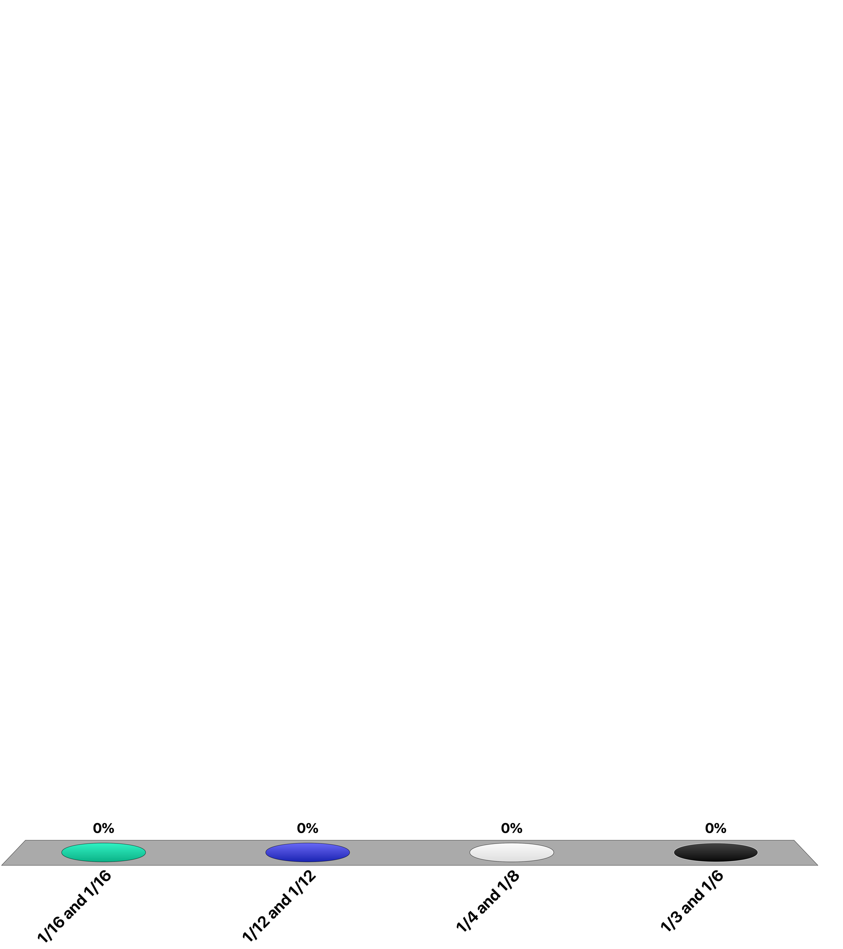
Consider the document: “Information retrieval is the task of finding the documents satisfying the information needs of the user”
Using MLE to estimate the unigram probability model, what is P(the|M_{d}) and P(information|M_{d})?
1/16 and 1/16
1/12 and 1/12
1/4 and 1/8
1/3 and 1/6

Slide 10
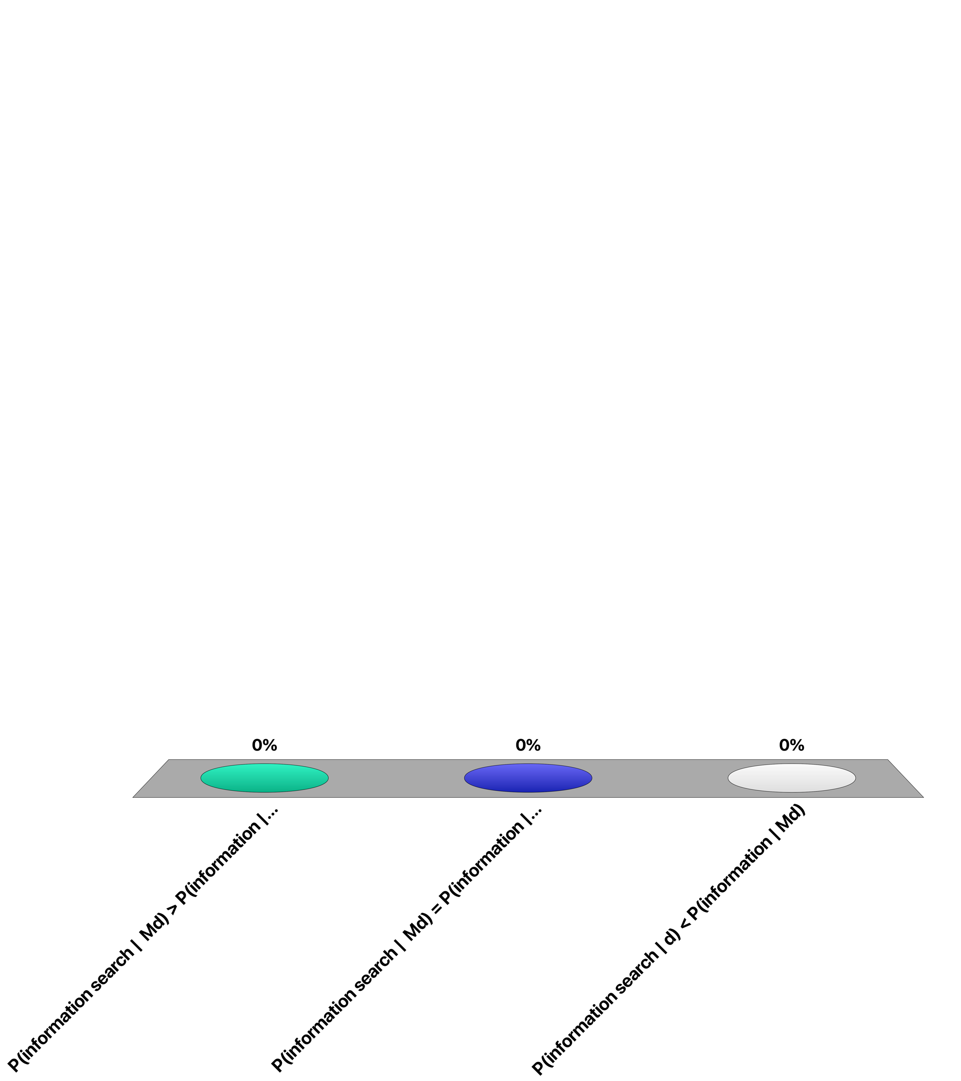
Consider the following document
d = “information retrieval and search”
P(information search | M_{d}) > P(information | M_{d})
P(information search | M_{d}) = P(information | M_{d})
P(information search | d) < P(information | M_{d})

Slide 11
Issues with MLE Estimation
Problem 1: if the query contains a term not occurring in the document then $\hat{P}\left(q | M_{d}\right)=0$ !
Problem 2: this is an estimation! A term that occurs once, might have been “lucky”, whereas another one with same probability to occur is not contained in the document
need to give non-zero probability to unseen terms!
Notes:
Applying the afore mentioned approach to estimate relevance of a document to a query has a practical problem: if the query contains a term not occurring in the document the estimated probability will be unavoidably zero, since one of the factors of the product computing that probability will be zero. In other words, the query cannot be generated by the document model, thus the document is not relevant to the query. This is not only impractical, but also not meaningful from a more theoretical perspective. Since we used MLE to generate the model, we were using the statistics of one specific document, that has been generated by a potentially complex model, that may contain other terms that just were not generated for this document.

Slide 12
Smoothing
Idea: add a small weight for non-occurring terms in a document, that is smaller than the normalized collection frequency
$$\hat{P}(t|M_{c})≤{cf}_{t}/T$$
where
${cf}_{t}$ = number of times term t occurs in collection
$T$ = total number of terms in collection
Smoothed estimate
$$\hat{P}\left(t | d\right)=λ{\hat{P}}_{mle}\left(t | M_{d}\right)+\left(1−λ\right){\hat{P}}_{mle}\left(t | M_{c}\right)$$
$M_{c}$ = language model of the whole collection
$λ$= tuning parameter
Notes:
To fix the aforementioned problem an approach called smoothing is applied. The basic idea is to assume that in fact every term potentially could occur in the document generated by its document model, including those that are not part of the actual document; only that the probability of terms not seen in the document is presumably less likely to occur as it would be expected to occur in the overall document collection. The smoothed estimate then combines the estimated likelihood to occur in the document according to the model generated from the document, with the estimated likelihood of a term occurring in the general document collection, modeled as a generic language model using the statistics from the document collection.

Slide 13
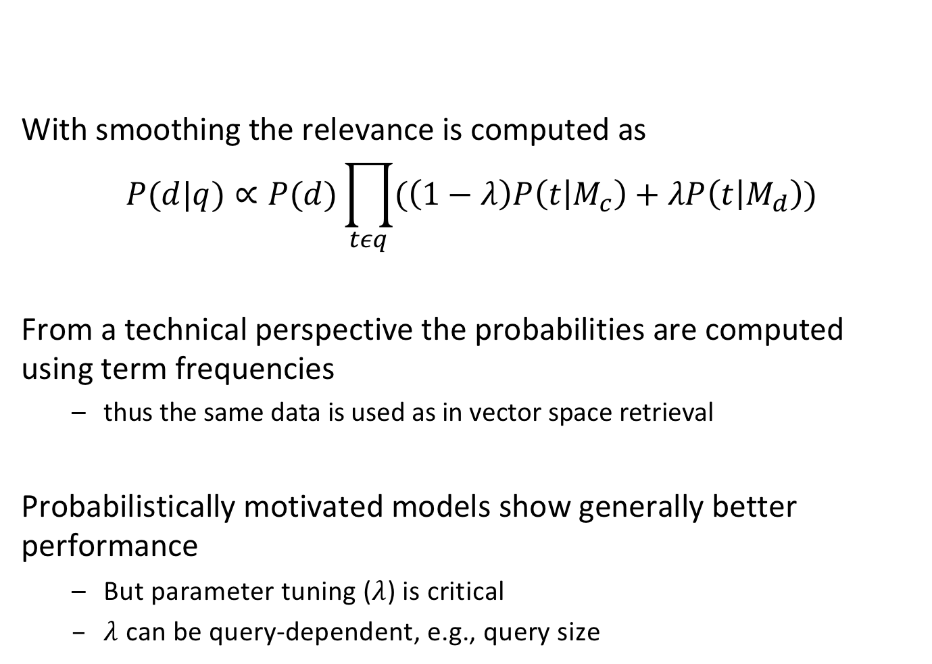
Probabilistic Retrieval
With smoothing the relevance is computed as
$$P(d|q)∝P(d)\prod_{tεq}{(\left(1−λ\right)P\left(t | M_{c}\right)+λP\left(t | M_{d}\right))}$$
From a technical perspective the probabilities are computed using term frequencies
thus the same data is used as in vector space retrieval
Probabilistically motivated models show generally better performance
But parameter tuning ($λ$) is critical
$λ$can be query-dependent, e.g., query size
Notes:
Here we summarize the approach for probabilistic retrieval. From a more technical perspective computational cost of probabilistic retrieval is not very different from vector space retrieval. The computation of the likelihoods for the document models requires determination of term frequencies, so in that sense it is equivalent. For the collection models the global term frequencies need to be computed, which again is similar to computing inverse document frequencies in a document collection.
In practice, the fine tuning of the model parameters (in that case $λ$) is essential for that the model performs well. Different methods have been devised for that. It is also possible to make the parameters dependent on the query, in particular on the query size.

Slide 14
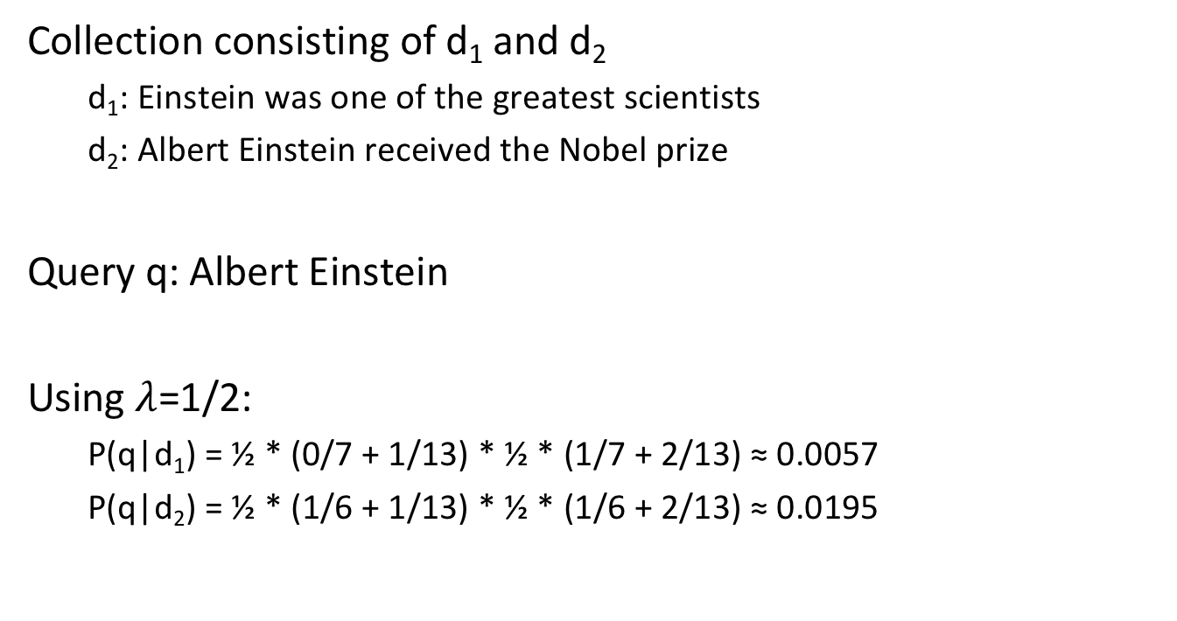
Example
Collection consisting of d₁ and d₂
d₁: Einstein was one of the greatest scientists
d₂: Albert Einstein received the Nobel prize
Query q: Albert Einstein
Using $λ$=1/2:
P(q|d₁) = ½ * (0/7 + 1/13) * ½ * (1/7 + 2/13) ≈ 0.0057
P(q|d₂) = ½ * (1/6 + 1/13) * ½ * (1/6 + 2/13) ≈ 0.0195
Notes:
This is a simple example illustrating the use of probabilistic retrieval. Notate that the document lengths of d1 and d2 are 7 and 6, and that the collection length is 13.

Slide 15
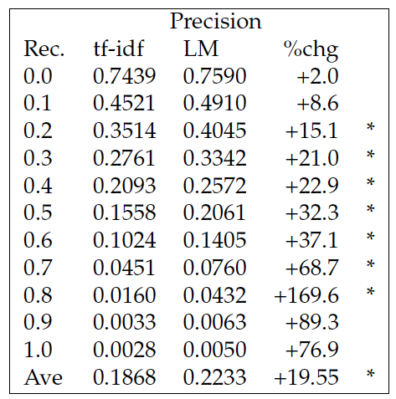
Example: Comparing VS and PR
Ponte & Croft, 1998
Notes:
This is a result reported from comparing vector space retrieval with probabilistic retrieval. It shows that in this experiment probabilistic retrieval improves precision significantly, in particular for higher values of recall. (LM = language model).

Slide 16
Overview of Retrieval Model Properties
 | Vector Space Model | Language Model | BM25 (another prob. Model)
Model | geometric | probabilistic | probabilistic
Length normalization | Requires extensions (pivot normalization) | Inherent to model | Tuning parameters
Inverse document frequency | Used directly | Smoothing and collection frequency has similar effect | Used directly
Multiple term occurrences | Taken into account | Taken into account | Ignored
Simplicity | No tuning required | Tuning essential | Tuning essential
Notes:
Here we compare the characteristics of the vector space model with the probabilistic retrieval model based on language models, and BM25 another model based on a probabilistic approach, that is today considered as one of the most performant retrieval models.
One aspect that is taken implicitly care off in the probabilistic retrieval model based on language models is normalization for document length. For vector space retrieval specific extensions have been developed, that modify the weighting parameters with the document length. For collections with widely varying document lengths this proved to be a useful improvement. In general, the vector space model is preferred when a quick and simple solution is sought. For probabilistic models better performance can be achieved, but this depends on careful parameter tuning which requires specialized expertise.

Slide 17
9. Latent Semantic Indexing

Slide 18
Latent Semantic Indexing
Vector space retrieval is vague and noisy
Based on index terms
Unrelated documents might be included in the answer set
apple (company) vs. apple (fruit)
Relevant documents that do not contain at least one index term are not retrieved
car vs. automobile
Observation
The user information need is more related to concepts and ideas than to index terms
Notes:
Despite its success and widespread use the vector space retrieval model suffers from some problems. The important insight is that terms may indicate a concept a user is interested in, but there does not necessarily exist a one to one correspondence between terms and concepts. As a consequence retrieval results may contain irrelevant documents, and relevant documents may be missed.

Slide 19
The Problem
Vector Space Retrieval handles poorly the following two situations
1. Synonymy: different terms refer to the same concept, e.g. car and automobile
Result: poor recall
2. Homonymy: the same term may have different meanings, e.g. apple, model, bank
Result: poor precision
Notes:
These problems are related to the fact that the same concepts can be expressed through many different terms (synonyms) and that the same term may have multiple meanings (homonyms). Studies show that different users use the same keywords for expressing the same concepts only 20% of the time.

Slide 20
Example: 3 documents
doc₁
doc₂
doc₃
apple blackberry orange vitamine fruit health tablet
apple blackberry smartphone orange carrier tablet swisscom
iOS iPad RIM mobile handy telcom provider
High similarity
No similarity
Notes:
Let’s illustrate the problem resulting from synomyms and homonyms by an example. Among these three documents at the level of terms doc1 and doc2 are (seem) highly related, whereas doc3 has no similarity with the other two documents. With human background knowledge it is however easy to see that in reality doc2 and doc3 are closely related, as they talk about mobile communications, whereas doc1 is completely unrelated to the others as it is about health and nutrition.

Slide 21
Key Idea
Map documents and queries into a lower-dimensional space composed of higher-level concepts
Each concept represented by a combination of terms
Fewer concepts than terms
Vehicle = {car, automobile, wheels, auto car, motor car}
Dimensionality reduction
Retrieval (and clustering) in a reduced concept space might be superior to retrieval in the high-dimensional space of index terms
Notes:
Thus it would be an interesting to base information retrieval methods on the use of concepts, instead of terms. To that end it is first necessary to define a "concept space" to which documents and queries are mapped, and compute similarity within that concept space. This idea is developed in the following. The concept space should ideally have much lower dimension than the term space, whose dimensionality is determined by the size of the vocabulary.

Slide 22
Using Concepts for Retrieval
d1
d1
t1
t1
d2
c1
d2
t2
t2
d3
c2
d3
t3
t3
d4
d4
Notes:
This figure illustrates the approach: rather than directly relating documents d and terms t, as in vector space retrieval, there exists an intermediate layer of concepts c to which both queries and documents are mapped. The concept space can be of a smaller dimension than the term space. In this small example we can imagine that the terms t1 and t2 are synonyms and thus related to the same concept c1. If now a query t2 is posed, in the standard vector space retrieval model only the document d1 would be returned, as it contains the term t2. By using the intermediate concept layer the query t2 would also return the document d2.

Slide 23
Example: Concept Space
doc₃
doc₂
iOS iPad RIM mobile handy telcom provider
fruit
apple blackberry smartphone orange carrier tablet swisscom
health
device
telco
Notes:
Applying this idea to our example before, we can imagine to have a concept space consisting of four concepts, two related to health, two related to mobile communication. When we consider now doc 2 and doc3 we can already recognize much better the close conceptual relationship the two documents have.

Slide 24
Similarity Computation in Concept Space
Concept represented by terms, e.g.
device = {iOS, iPad, RIM, mobile, handy, tablet, apple, blackberry}
Document represented by concept vector, counting number of concept terms, e.g.
doc₁ = (4, 3, 3, 1) doc₃ = (0, 0, 5, 2)
Similarity computed by scalar product of normalized concept vectors
Notes:
We may consider concepts as being represented by sets of terms, and documents by concept vectors that count how many concept terms occur in the document. Using this approach we would obtain the non-normalized concept vectors doc1 = (4,3,3,1), doc2=(3,1,3,3) and doc3=(0,0,5,2).

Slide 25
Result
doc₁ = (4,3,3,1)
doc₂=(3,1,3,3)
doc₃=(0,0,5,2)
apple blackberry orange vitamine fruit health tablet
apple blackberry smartphone orange carrier tablet swisscom
iOS iPad RIM mobile handy telcom provider
Similarity(doc₁, doc₂) = 0.245
Similarity(doc₂, doc₃) = 0.3
Similarity(doc₁, doc₃) = 0.22
Notes:
After normalizing these vectors we compute the cosine similarities among the resulting concept vectors and obtain:
Sim (2,3) = 0.3
Sim (1,2) = 0.245
Sim (1,3) = 0.22
This result shows that indeed documents 2 and 3 are the more related ones, though still some confusion remains due to the high number of synonyms occurring in these documents.

Slide 26
Basic Definitions
Problem: how to identify and compute “concepts” ?
Consider the term-document matrix
Let M_{ij} be a term-document matrix with m rows (terms) and n columns (documents)
To each element of this matrix is assigned a weight w_{ij} associated with t_{i} and d_{j}
The weight w_{ij} can be based on a tf-idf weighting scheme
Notes:
The problem is to identify a method that identifies and characterizes important concepts in document collections. One approach would be to perform this task manually, e.g. by using a predefined ontology and let users annotate documents using terms of the ontology. This is an approach that his been used in libraries, but is labor intensive. Thus we will now present a method that performs the task of concept identification and document classification by concepts automatically. Starting point for the method is the term-document matrix that we have introduced for vector space retrieval with weigths based on a tf-idf weighting scheme.

Slide 27
Computing the Ranking Using M
Scalar product
m
M^{t} . q
M^{t}
q
query . doc1
doc1
query . doc2 ...
doc2
doc3
m
query
n
doc4
doc5
query . doc6
doc6
Notes:
We can understand the process of producing a retrieval results in vector space retrieval as a matrix operation. This is illustrated in this figure. The ranking is the result of computing the product of a query vector q with the term-document matrix M. We assume that all columns in M and q are normalized to 1.

Slide 28
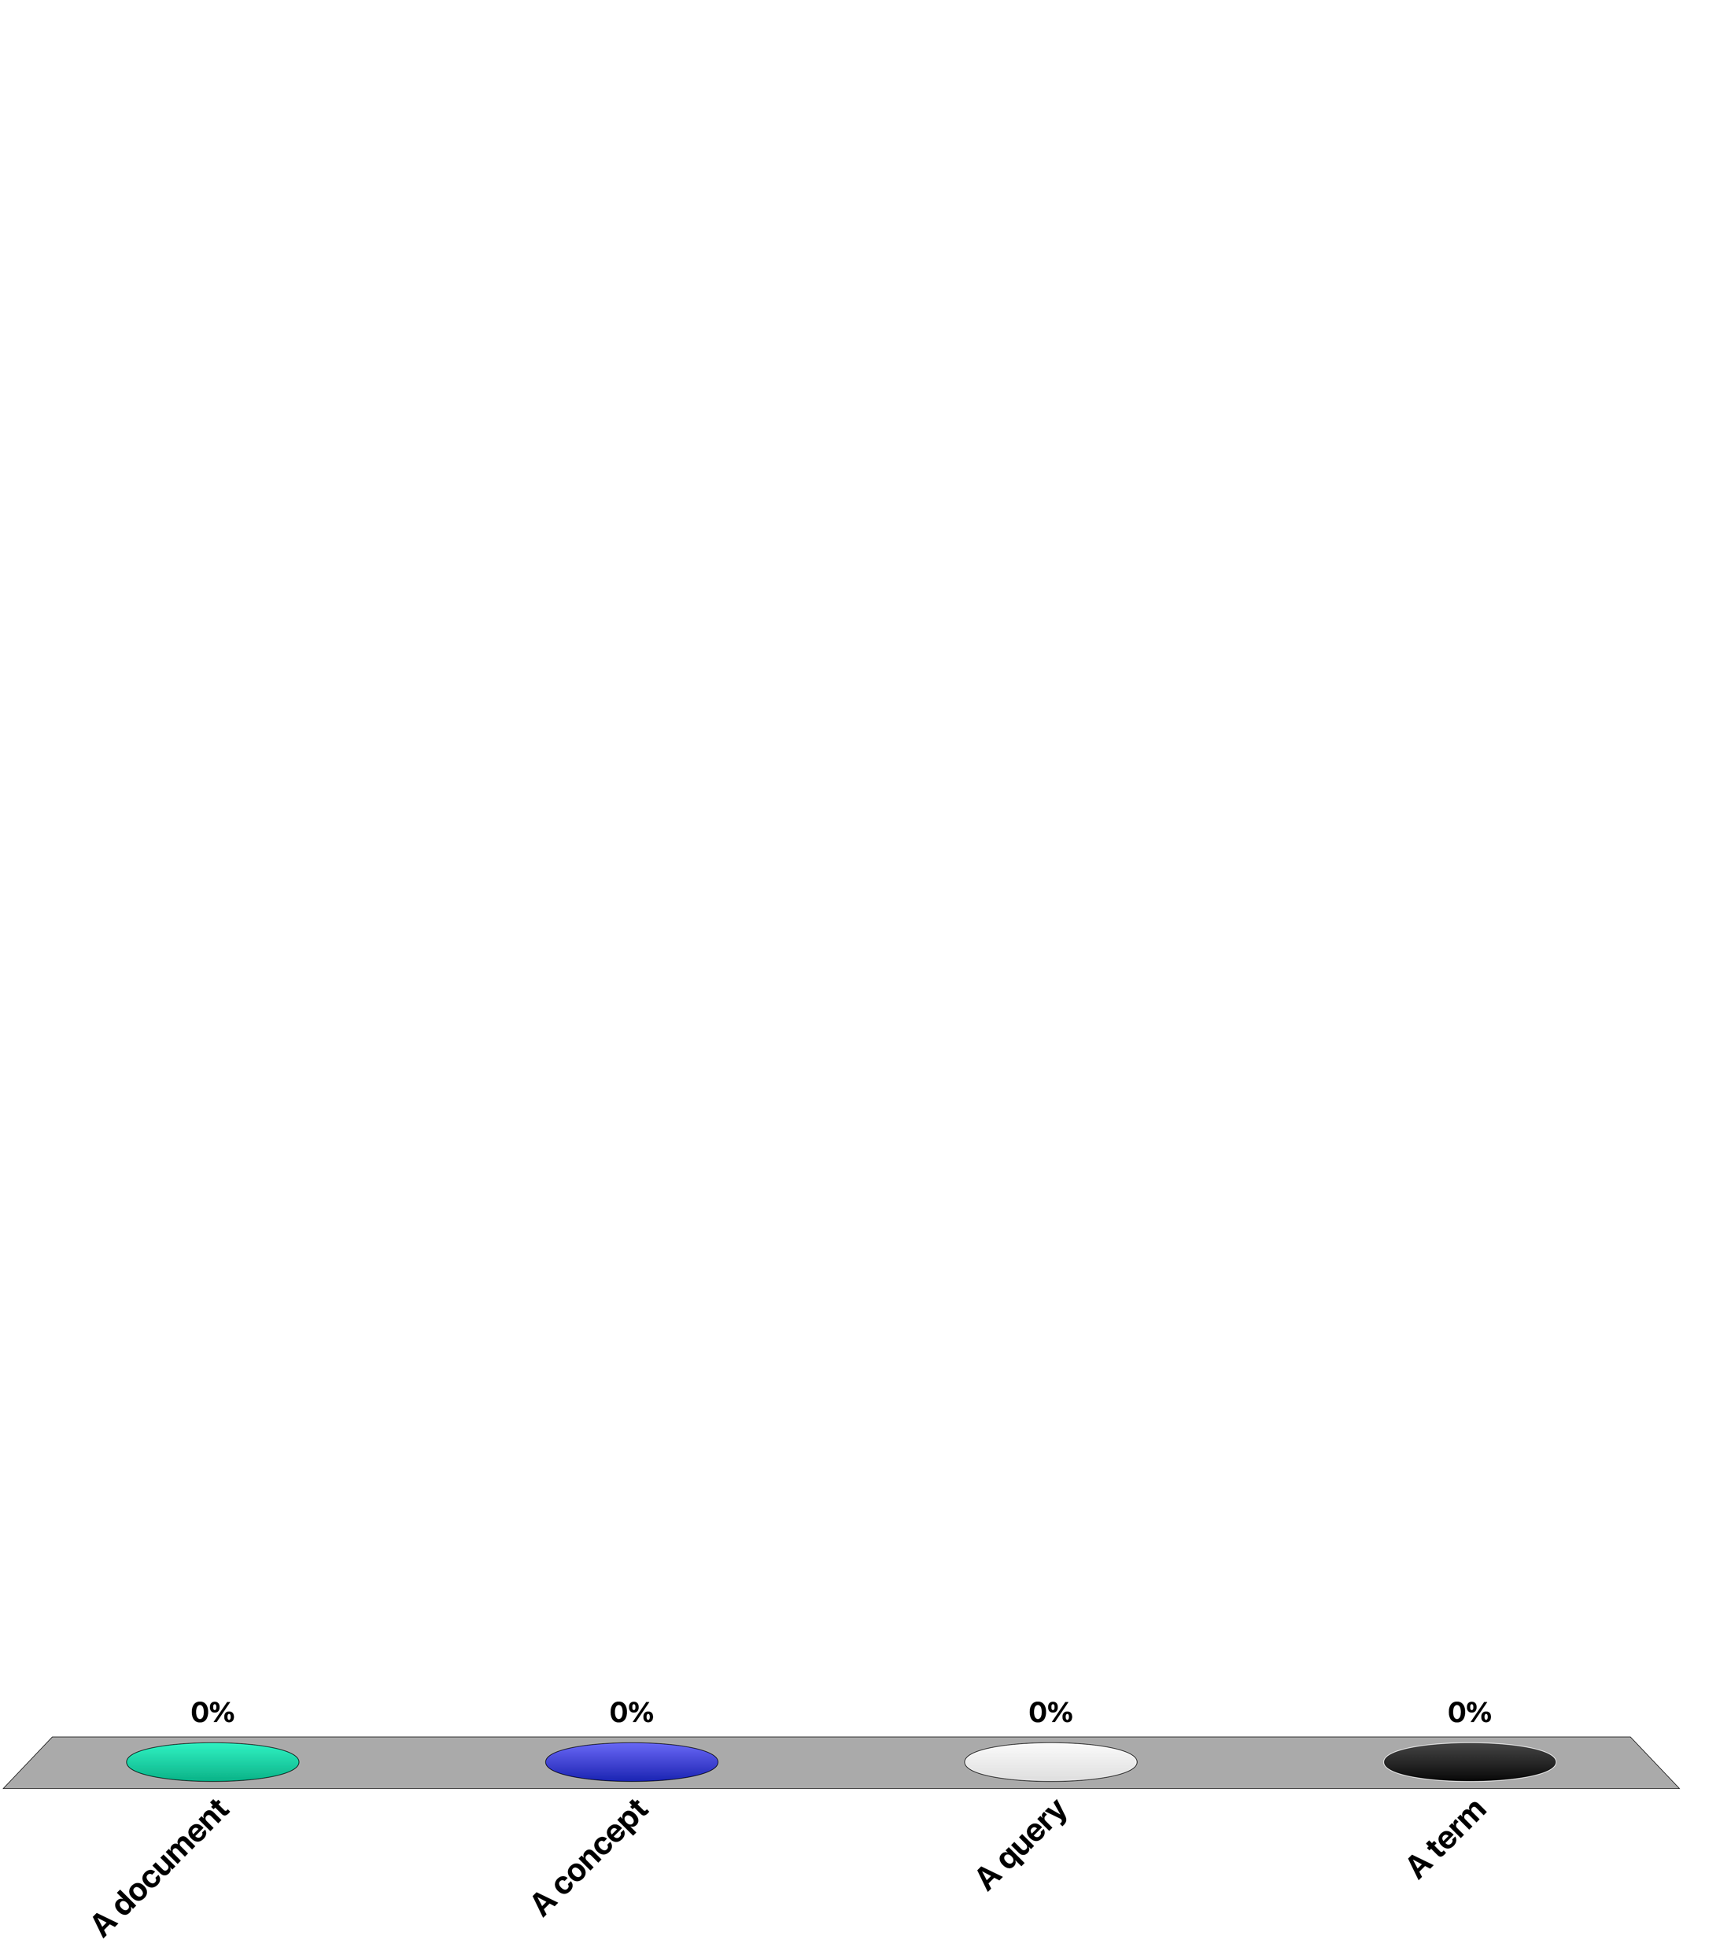
In vector space retrieval each row of the matrix M corresponds to
A document
A concept
A query
A term

Slide 29
Identifying Top Concepts
Key Idea: extract the essential features of M^{t} and approximate it by the most important ones
“Top concept”
Transformation M
Unit ball
Transformed ball
Notes:
One way to understand of how concepts can be extracted from a document collection is to consider the effect of the term-document matric on data. If we apply this matrix to a (high-dimensional) unit ball it will distort this ball into an ellipsoid. This ellipsoid will have one direction with the strongest distortion. We may think of this direction as corresponding to a particularly important concept of the document collection.

Slide 30
Singular Value Decomposition (SVD)
Represent Matrix M as M = K.S.D^{t}
K and D are matrices with orthonormal columns
K.K^{t} = I = D.D^{t}
S is an r x r diagonal matrix of the singular values sorted in decreasing order where r = min(m, n), i.e. the rank of M
Such a decomposition always exists and is unique (up to sign)
Notes:
To extract this particularly important directions of a matrix mapping, a standard mathematical construction from linear algebra is used, the singular value decomposition (SVD). SVD decomposes a matrix into the product of three matrices. The middle matrix S is a diagonal matrix, where the elements of this matrix are the singular values of the matrix M.

Slide 31

Construction of SVD
K is the matrix of eigenvectors derived from M.M^{t}
D is the matrix of eigenvectors derived from M^{t}.M
Algorithms for constructing the SVD of a m x n matrix have complexity O(n³) if m$≤$n
Notes:
Formally the SVD can be computed by constructing eigenvectors of matrices derived from the original matrix M. This computationg can be performed in O(n^3). Note that the complexity is considerable, which makes the approach computationally expensive. There exist however also approximation techniques to perform this decomposition more efficiently.

Slide 32
Interpretation of SVD
We can write M as sum of outer vector products
The s_{i} are ordered in decreasing size
By taking only the largest ones we obtain a «good» approximation of M (least square approximation)
The singular values s_{i} are the lengths of the semi-axes of the hyperellipsoid E defined by
Each value s_{i} corresponds to a dimension of a "concept space »
Notes:
One way to understand of how the SVD extracts the important concepts from the term-document matrix is the following: the decomposition can be used to rewrite the original matrix as the sum of components that are weighted by the singular values. Thus we can obtain approximations of the matrix by only considering the larger singular values. The SVD after eliminating less important dimensions (smaller singular values) can be interpreted as a least square approximation to the original matrix. The symbol ⊗ denotes the outer product of two vectors, d_{i} is the i-th row of D.
The singular values have also a geometrical interpretation, as they tell us how a unit ball (||x||=1) is distorted when the linear transformation defined by the matrix M is applied to it. We can interpret the axes of the hyperellipsoid E as the dimensions of the concept space.

Slide 33
Illustration of SVD
n
r
r
n
m
M
=
K
•
S
•
D^{t}
r
Vectors represent
documents in concept space
Vectors represent
terms in concept space
m x n
m x r
r x r
r x n
Assuming m ≤ n
Notes:
This figure illustrates the structure of the matrices generated by the SVD. In general, m <= n, i.e., the number of documents may be larger than the size of the vocabulary. The rows in K can then be interpreted as the representation of terms in the concept space, and the rows in D as the representation of documents in the concept space.

Slide 34
Illustration of SVD – Another Perspective
n
r
r
n
m
M
=
K
•
S
•
D^{t}
r
Vectors represent
concepts in document space
Vectors represent
concepts in term space
m x n
m x r
r x r
r x n
Assuming m ≤ n
Notes:
We can also see of how the concepts are represented by terms respectively documents. In particular, each concepts is now described as a weighted vector of terms.

Slide 35
Latent Semantic Indexing
In the matrix S, select only the s largest singular values
Keep the corresponding columns in K and D
The resultant matrix is called M_{s} and is given by
M_{s} = K_{s}.S_{s}.D_{s}^{t} where s, s < r, is the dimensionality of the concept space
The parameter s should be
large enough to allow fitting the characteristics of the data
small enough to filter out the non-relevant representational details
Notes:
Using the singular value decomposition, we can now derive an "approximation" of M by taking only the s largest singular values in matrix S. The choice of s determines on how many of the "important concepts" the ranking will be based on. The assumption is that concepts with small singular value in S are rather to be considered as "noise" and thus can be neglected. The resulting method is called Latent Semantic Indexing.

Slide 36
Illustration of Latent Semantic Indexing
n
s
n
m
M_{s}
=
K_{s}
•
S_{s}
•
D_{s}^{t}
s
Document vectors
Term vectors
m x n
m x s
s x s
s x n
Notes:
This figure illustrates the structure of the matrices after reducing the dimensionality of the concept space to s, when only the first s singular values are kept for the computation of the ranking. The rows in matrix K_{s} correspond to term vectors, whereas the columns in matrix D_{s}^{t} correspond to document vectors. By using the cosine similarity measure between columns of matrix D_{s}^{t} the similarity of documents can be computed.

Slide 37
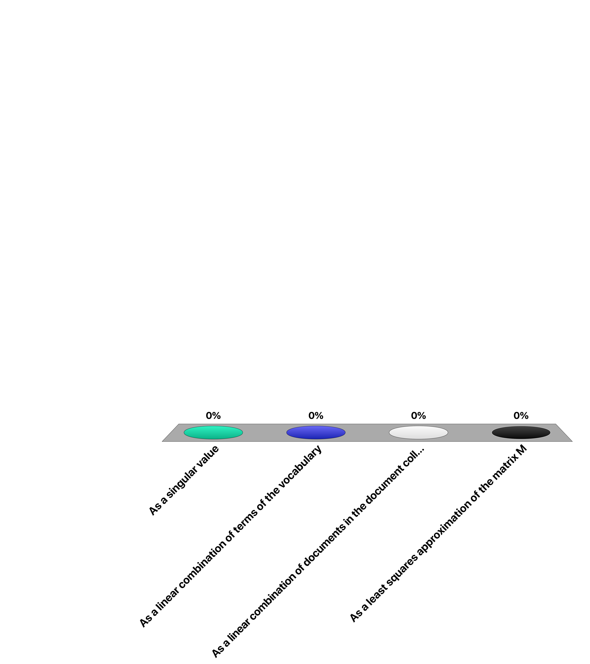
Applying SVD to a term-document matrix M. Each concept is represented in K
as a singular value
as a linear combination of terms of the vocabulary
as a linear combination of documents in the document collection
as a least squares approximation of the matrix M

Slide 38

The number of term vectors in the matrix K_{s} used for LSI
Is smaller than the number of rows in the matrix M
Is the same as the number of rows in the matrix M
Is larger than the number of rows in the matrix M

Slide 39
Answering Queries
Documents can be compared by computing cosine similarity in the concept space, i.e., comparing their columns (D_{s}^{t})_{i} and (D_{s}^{t})_{j} in matrix D_{s}^{t}
A query q is treated like one further document
it is added as an additional column to matrix M
the same transformation is applied to this column as for mapping M to D
Notes:
After performing the SVD the similarity of different documents can be determined by computing the cosine similarity measure among their representation in the concept space (the columns of matrix D_{s}^{t}). Queries are considered like documents that are added to the document collection. Answering queries then corresponds then to computing the similarity between the query considered as a document and the documents in the collection.

Slide 40
Mapping Queries
Mapping of M to D
M = K.S.D^{t} S⁻¹.K^{t} .M = D^{t} (since K.K^{t} = 1) D = M^{t} .K.S⁻¹
Apply same transformation to q:
q* = q^{t}.K_{s}.S_{s}⁻¹
Then compare transformed vector by using the standard cosine measure
Notes:
This construction works as follows: when a new column (the query) is added to M, we have to apply the same transformation to this new column, as to the other columns of M, in order to produce the corresponding column in the matrix D_{s}^{t}, representing documents in the concept space. We exploit the fact that K_{s} ^{t}.K_{s} =1.
Since M_{s} = K_{s} .S_{s} .D_{s}^{t} we obtain S_{s} ^{–1} .K_{s} ^{t} .M_{s} = D_{s}^{t} or D_{s}= M_{s} ^{t} .K_{s} .S_{s} ^{–1 .}
This is the transformation that is applied to the query vector q to obtain a query vector q* in the concept space. After that step, the similarity of the query to the documents in the concept space can be computed. ((D_{s}^{t})_{i} denotes the i-th column of matrix D_{s}^{t})

Slide 41
Illustration of LSI Querying
n
s
q^{t}
n
q*
m
M_{s}
=
K_{s}
•
S_{s}
•
D_{s}^{t}
s
Document vectors
Term vectors
m x n
m x s
s x s
s x n
Notes:
This figure illustrates of how a query vector is treated like an additional document vector.

Slide 42
Example: Documents
B1 A Course on Integral Equations
B2 Attractors for Semigroups and Evolution Equations
B3 Automatic Differentiation of Algorithms: Theory, Implementation, and Application
B4 Geometrical Aspects of Partial Differential Equations
B5 Ideals, Varieties, and Algorithms: An Introduction to Computational Algebraic Geometry and Commutative Algebra
B6 Introduction to Hamiltonian Dynamical Systems and the N-Body Problem
B7 Knapsack Problems: Algorithms and Computer Implementations
B8 Methods of Solving Singular Systems of Ordinary Differential Equations
B9 Nonlinear Systems
B10 Ordinary Differential Equations
B11 Oscillation Theory for Neutral Differential Equations with Delay
B12 Oscillation Theory of Delay Differential Equations
B13 Pseudodifferential Operators and Nonlinear Partial Differential Equations
B14 Sinc Methods for Quadrature and Differential Equations
B15 Stability of Stochastic Differential Equations with Respect to Semi-Martingales
B16 The Boundary Integral Approach to Static and Dynamic Contact Problems
B17 The Double Mellin-Barnes Type Integrals and Their Applications to Convolution Theory
Notes:
This is an example of a (simple) document collection that we will use in the following as running example.

Slide 43
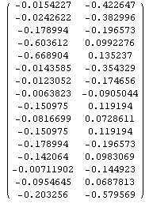
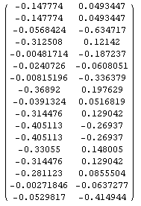
Example (SVD, s=2)
K_{s}
S_{s}
D_{s}
Notes:
In the following we give a complete illustration of computing LSI for our running example. This is SVD for Term-Document Matrix from our running example.

Slide 44


Mapping of Query Vector into Concept Space
q*
q^{t}
K_{s}
S_{s}⁻¹
=
(query "application theory")
Notes:
In this step we compute the query vector in the concept space.

Slide 45
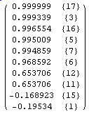
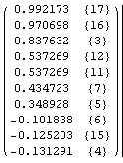
Ranked Result
s=2
s=4
Notes:
This is the ranking produced for the query for different values of s.

Slide 46
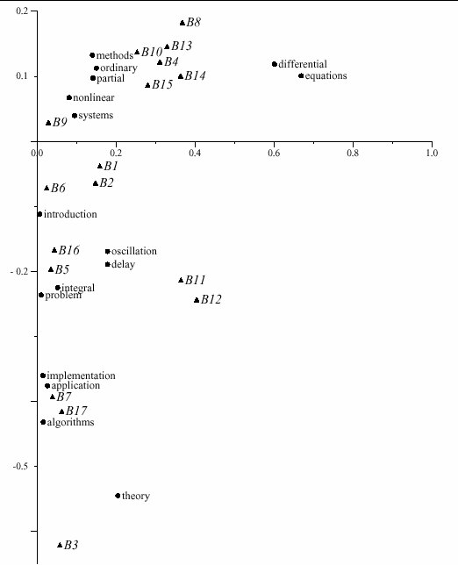
Plot of Terms and Documents in 2-d Concept Space
Notes:
Since in our example the concept space has two dimensions, we can plot both the documents and the terms in this 2-dimensional space. It is interesting to observe of how semantically "close" terms and documents cluster in the same regions. This illustrates very well the power of latent semantic indexing in revealing the « essential concepts » in document collections.

Slide 47
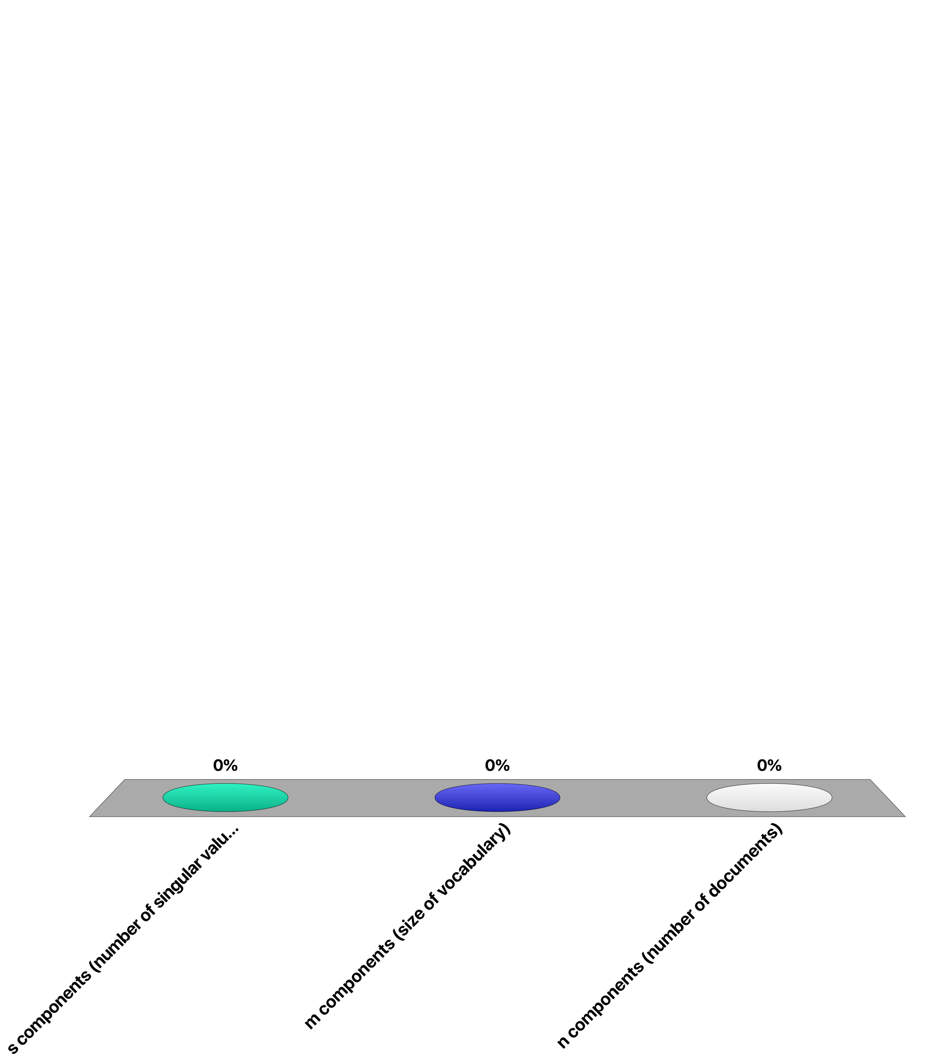
A query transformed into the concept space for LSI has …
s components (number of singular values)
m components (size of vocabulary)
n components (number of documents)

Slide 48
Discussion of Latent Semantic Indexing
Latent semantic indexing provides an interesting conceptualization of the IR problem
Advantages
It allows reducing the complexity of the underlying concept representation
Facilitates interfacing with the user
Disadvantages
Computationally expensive
Poor statistical explanation
Notes:
From a modelling perspective LSI suffers from poor explanatory power. For example, the least squares approximation concept is related to the assumption that term frequencies are normally distributed, which is in contradiction with the observation that term frequencies are power law distributed.

Slide 49
Alternative Techniques
Probabilistic Latent Semantic Analysis
Based on Bayesian Networks
Latent Dirichlet Allocation
Based on Dirichlet Distribution
State-of-the-art method for concept extraction
Same objective of creating a lower-dimensional concept space based on the term-document matrix
Better explained mathematical foundation
Better experimental results
Notes:
The conceptual problems of LSI have triggered significant efforts in developing better suited models for concept extraction. The most recent and successful result of this has been the development of a method based on the use of Dirichlet distributions. Like LSI it produces a concept space, where concepts are represented as term vectors. The method has better theoretical foundations and empirically it produces better results, and is nowadays considered as the golden standard. The approach is mathematically more involved than LSI, and therefore we will not be able to develop this method in this course.

Slide 50
Latent Dirichlet Allocation (LDA)
Idea: assume a document collection is (randomly) generated from a known set of topics (probabilistic generative model)
money
money
bank
loan
DOCUMENT 1: money¹ bank¹ bank¹ loan¹ river² stream² bank¹ money¹ river² bank¹ money¹ bank¹ loan¹ money¹ stream² bank¹ money¹ bank¹ bank¹ loan¹ river² stream² bank¹ money¹ river² bank¹ money¹ bank¹ loan¹ bank¹ money¹ stream²
.8
loan
bank
bank
Topic is a mixture of words
loan
.2
Document is a mixture of topics
TOPIC 1
.3
river
bank
DOCUMENT 2: river² stream² bank² stream² bank² money¹ loan¹ river² stream² loan¹ bank² river² bank² bank¹ stream² river² loan¹ bank² stream² bank² money¹ loan¹ river² stream² bank² stream² bank² money¹ river² stream² loan¹ bank² river² bank² money¹ bank¹ stream² river² bank² stream² bank² money¹
stream
river
.7
river
bank
stream
TOPIC 2
Notes:
This illustration shows the basic idea underlying LDA: it is assumed that there exist topics that are represented as mixtures of words. In the example we see words that are related to two meanings of “bank”, the financial institution and the river bank, and are represented by different related works. Then, documents are supposed to be generated from a mixture of topics, where the mixture is defined by some weights, as indicated in the figure. As a result each document contains terms form its associated topics in the right proportion.
Similar to the probabilistic language model used in information retrieval, we have here another example of a probabilistic generative model.

Slide 51
Document Generation using a Probabilistic Process
For each document, choose a mixture of topics
For every word position, sample a topic from the topic mixture
For every word position, sample a word from the chosen topic
TOPIC MIXTURE
TOPIC
WORD
TOPIC
WORD
...
...
Notes:
Given the underlying model we can define a probabilistic process for generating documents.

Slide 52
LDA: Topic Identification
Approach: Inverting the process: given a document collection, reconstruct the topic model
?
DOCUMENT 1: money? bank? bank? loan? river? stream? bank? money? river? bank? money? bank? loan? money? stream? bank? money? bank? bank? loan? river? stream? bank? money? river? bank? money? bank? loan? bank? money? stream?
TOPIC 1
?
DOCUMENT 2: river? stream? bank? stream? bank? money? loan? river? stream? loan? bank? river? bank? bank? stream? river? loan? bank? stream? bank? money? loan? river? stream? bank? stream? bank? money? river? stream? loan? bank? river? bank? money? bank? stream? river? bank? stream? bank? money?
?
TOPIC 2
Notes:
The challenge is to determine the probabilistic model. The situation we consider in practice is that a set of documents is given, and we intend to reconstruct the (most likely) probabilistic process that has generated this document collection. This is a difficult problem to solve.

Slide 53
Latent Dirichlet Allocation
Topics are interpretable unlike the arbitrary dimensions of LSI
Distributions follow a Dirichlet distribution
Construction of topic model is mathematically involved, but computationally feasible
Considered as the state-of-the art method for topic identification
Notes:
We do not present the details of LDA here, as the method is mathematically fairly involved. However, it is important to note that it is considered today as the state-of-the-art method of topic detection.

Slide 54
Use of Topic Models
Unsupervised Learning of topics
Understanding main topics of a topic collection
Organizing the document collection
Use for document retrieval: use topic vectors instead of term vectors to represent documents and queries
Document classification (Supervised Learning): use topics as features
Notes:
Topic models provide a representation of documents at a conceptual level. Therefore they are applied in many different contexts, including document retrieval and classification.

Slide 55
Summary
0
1
0
1
0
0
0
0
0
1
0
0
1
0
0
1
0
0
0
0
1
0
1
0
0
0
0
1
0
0
0
0
0
1
1
1
0
0
1
0
1
0
0
0
1
0
0
0
1
0
0
1
1
1
0
1
0
0
0
0
0
1
1
0
0
1
0
0
1
VS model maps documents to
sparse term vectors
Topic model maps documents to
dense vectors (dimension = topic)
Each topic corresponds to a distribution over terms
Notes:
This illustration summarizes the connection among the vector space model, which was introduced for information retrieval and topic models that produce low-dimensional (dense) representation of documents.

